Slide 1



ABV- INDIAN INSTITUTE OF INFORMATION TECHNOLOGY AND MANAGEMENT, GWALIOR
DataBase Management System
MINI PROJECT
Topic : Movie-Ticket-Booking-System

Slide 2


TEAM MEMBERS -
Aman Kumar Ansh Rusia Shubhajeet Pradhan Varun Kumar Tiwari
2020IMT-007
2020IMT-012
2020IMT-097
2020IMT-112

Slide 3
Introduction
As the name suggests the movie ticket management system is a database management system for a multiplex. This Project aims to provide an insight of such Movie ticket management System. The database is designed to accommodate multiple theater rooms at same time to have a hassle free experience for the customer.
This management system is highly flexible and is well efficient for managing all information about the customer, movie and seats. The key focus is: well management of data and easy retrieval of information. Some key benefits of this projects are :-
Data consistency, Easy to handle, Easy data updating and Easy record keeping, Data redundancy can be avoided to some extent.

Slide 4
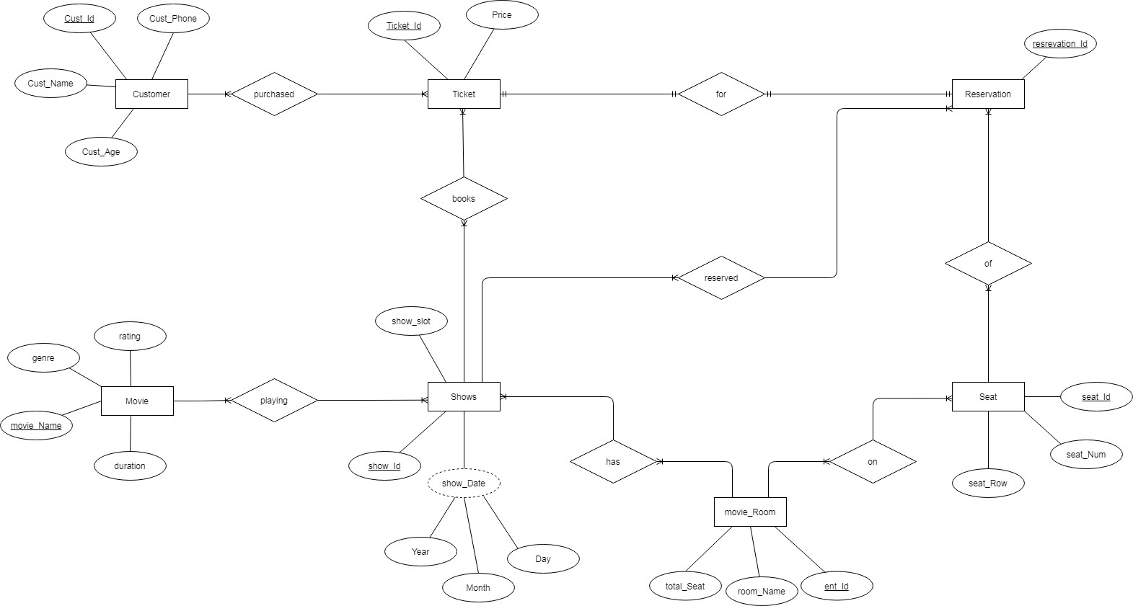
Entity Relationship Model

Slide 5
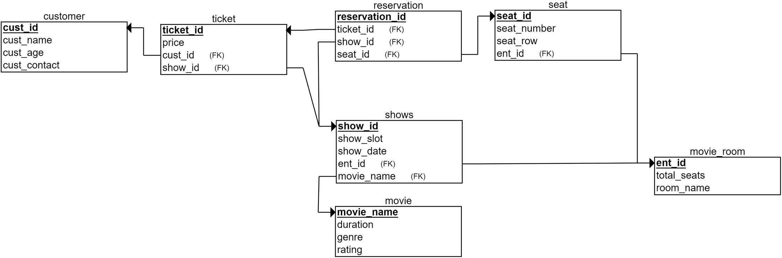
Relationship Schema

Slide 6
Customer Entity
Functional Dependency = {cust_id --> cust_age, cust_name, cust_phone} Candidate key = cust_id
Movie Entity
Functional Dependency = { movie_name --> room_name total_seats} Candidate key = movie_name
FUNCTIONAL DEPENDENCIES
Movie Room Entity
Functional Dependency = { ent_id --> room_name total_seats} Candidate key = ent_id
Reservation Entity
Functional Dependency = { reservation_id --> ticket_id, show_id, seat_id} Candidate key = reservation_id

Slide 7
Seat Entity
Functional Dependency = { seat_id --> seat_number, seat_row, ent_id} Candidate key = seat_id
FUNCTIONAL DEPENDENCIES
Shows Entity
Functional Dependency = { show_id --> show_slot, show_date, ent_id, movie_name}
Candidate key = show_id
Ticket Entity
Functional Dependency = { ticket_id --> price, cust_id, show_id} Candidate key = ticket_id

Slide 8


Normalisation
1 NF - In our management system, Customer, Ticket, Reservation, Seat, Movie Room, Shows and Movie has no attribute is multi- valued or composite attribute. Therefore, it is in First Normal Form. 2 NF - As there is no non-prime attribute defined by set of candidate key therefore, it is in Second Normal Form.
3 NF - In our entire relation there is no transitive dependency(i.e no non-prime attribute determining another non-prime attribute) so, it is in 3 NF also as well as every super key is present on the left side of the functional dependency so, it is in 3 NF.
BCNF - Since, each and every functional dependency has supee key on left therfore it is in Boyce–Codd Normal Form.

Slide 9



TABLES -

Slide 10
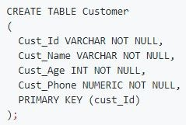
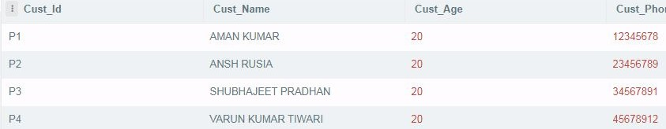
Customer Table

Slide 11
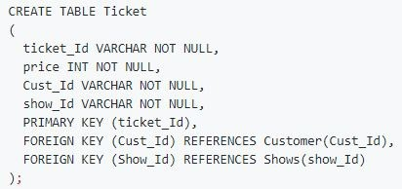
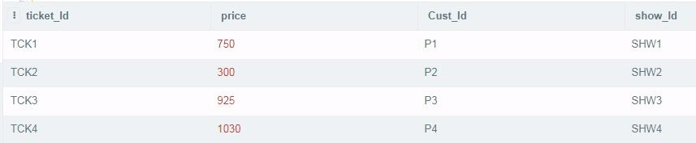
Ticket Table

Slide 12
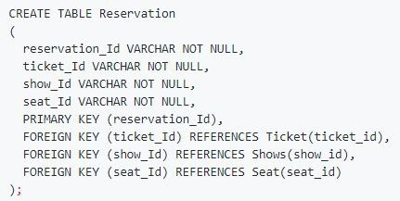

Reservation Table

Slide 13
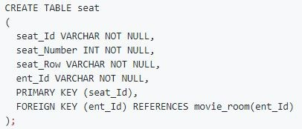
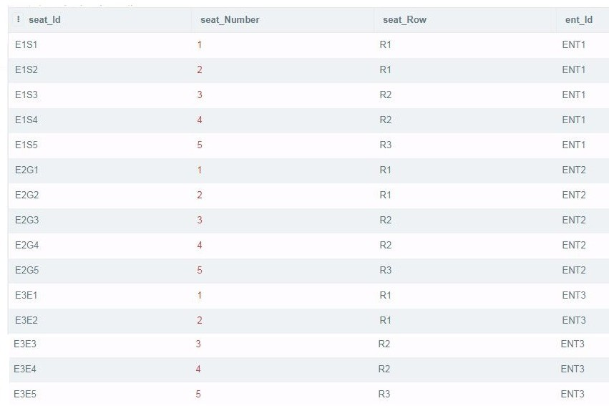
Seat Table

Slide 14
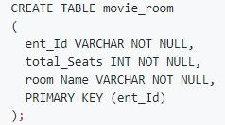
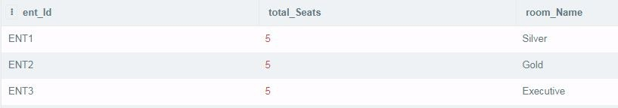
Movie Room Table

Slide 15
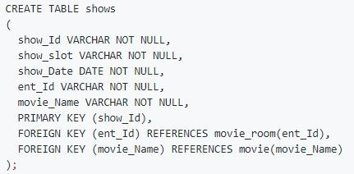
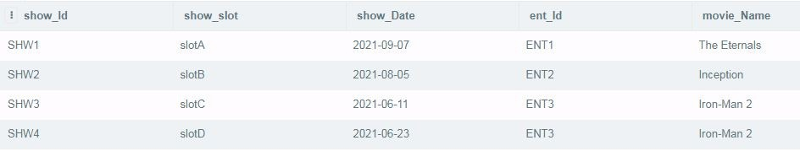
Show Table

Slide 16
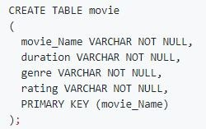
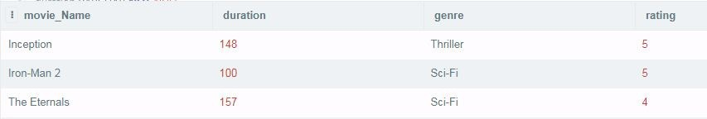
Movie Table

Slide 17
SQL Queries -

Slide 18

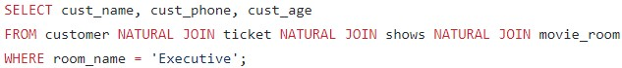
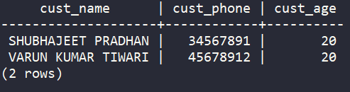

1. Show all the details of people who booked movie for only "Executive Class".

Slide 19
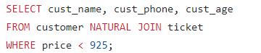
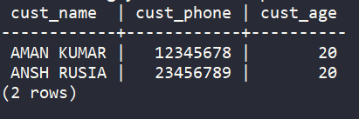
2. Show all the details of peoples who booked for a movie whose price is greater than 750.

Slide 20
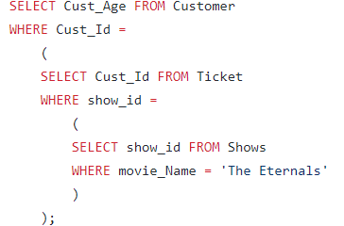
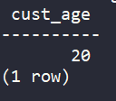
3. Show the age of all customers who are watching the movie "The Eternals".

Slide 21
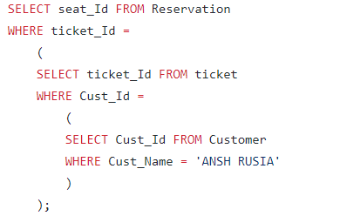
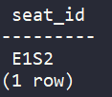
4. Show seat id of customer whose name is "ANSH RUSIA".

Slide 22
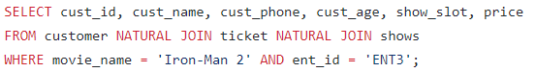
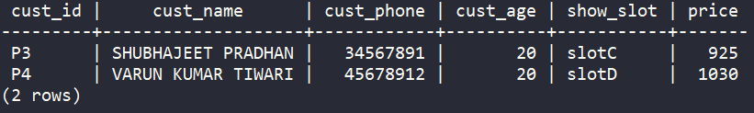
5. Show all the Customers who is watching "Iron-Man 2" in "ENT 3"

Slide 23
RA Expression-

Slide 24
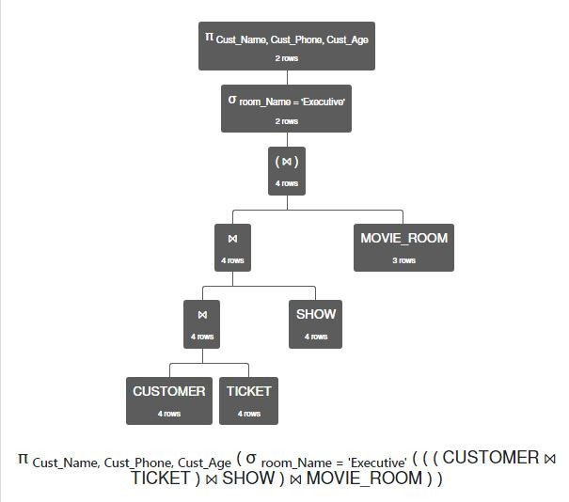
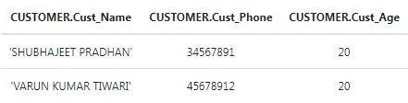
1. Show all the details of people who booked movie for only "Executive Class".

Slide 25
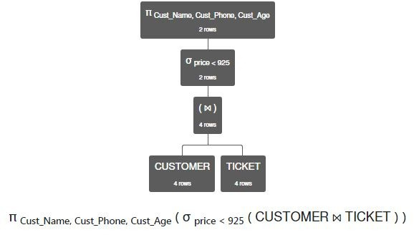
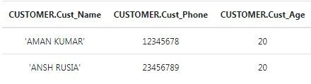
2. Show all the details of peoples who booked for a movie whose price is greater than 750.

Slide 26
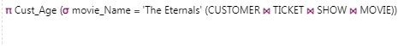
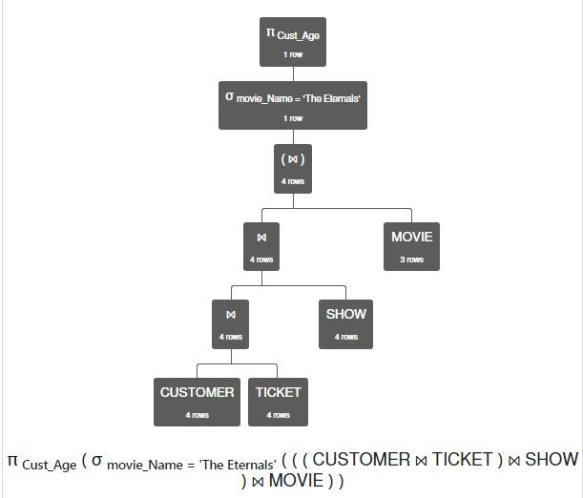
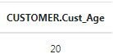
3. Show the age of all customers who are watching the movie "The Eternals".

Slide 27
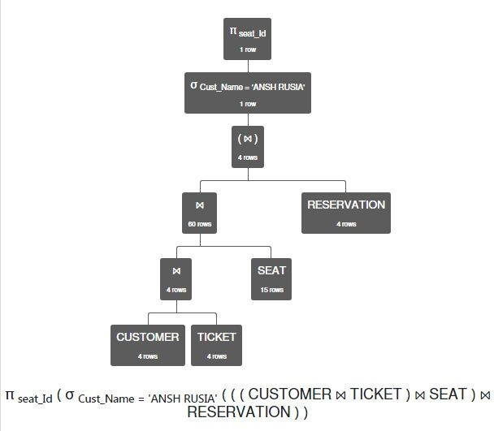
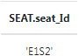
4. Show seat id of customer whose name is "ANSH RUSIA".

Slide 28
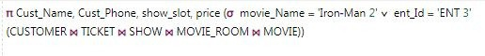
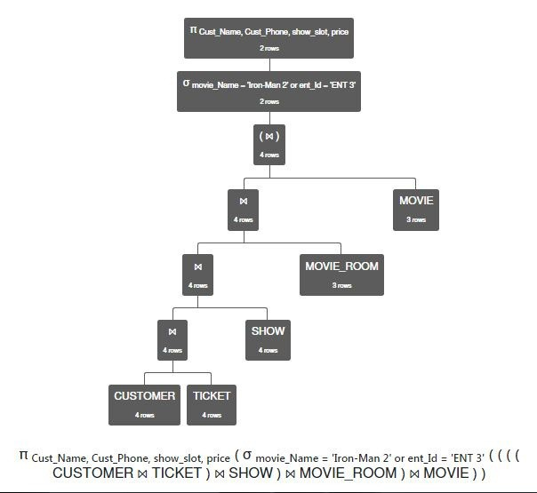
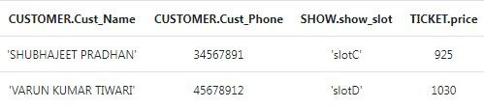
5. Show all the Customers who is watching "Iron-Man 2" in "ENT 3"

